Slide 2
8
3
Period 6

Slide 3
①
Warm-up and review
Contents
②
Read and complete.
③
Let’s write.
④
Project
⑤
Fun corner and wrap-up

Slide 4
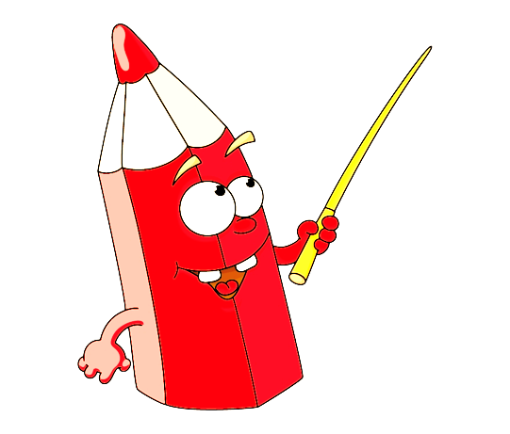
①
Warm-up and review

Slide 5
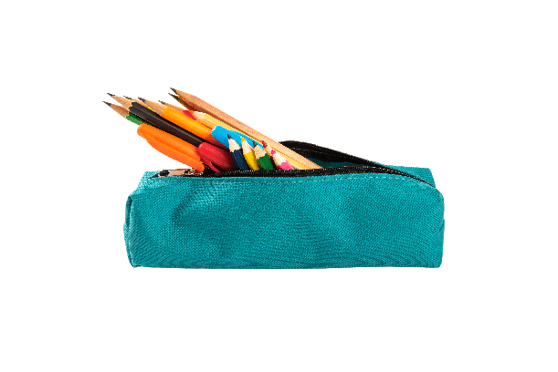
①
②
③
④
eraser pencil case book pen

Slide 6
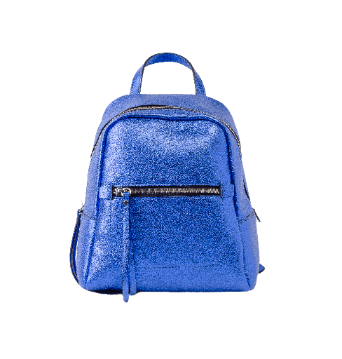
①
②
③
④
ruler eraser school bag book

Slide 7
Way to go

Slide 8
②
Read and complete.

Slide 9
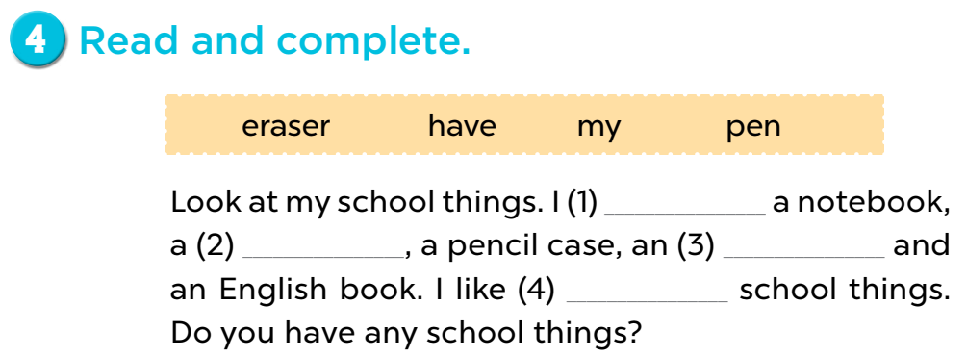
have
pen
eraser
my

Slide 10
③
Let’s write.

Slide 11
Mary
a book
a pencil

Slide 12
Game: Spin the wheel
Notes:
- Divide the class into 4 groups.
- A pupil from each group comes to the board, spin the wheel, look at the chosen picture, then write the answer on the board.

Slide 13
SPIN THE WHEEL
I have ……… and ……… .

Slide 14
④
Project

Slide 15
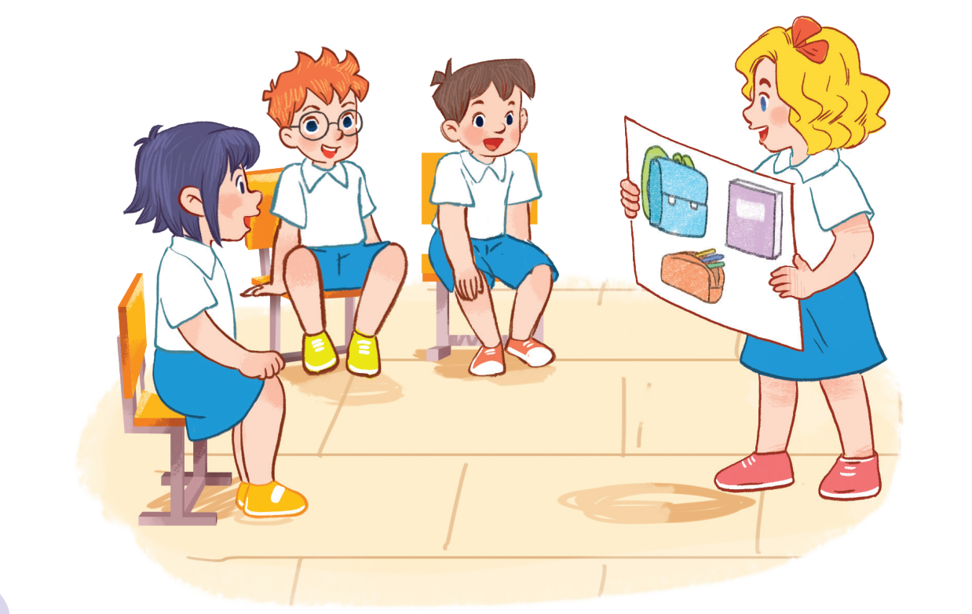

Slide 16
⑤
Fun corner and wrap-up

Slide 17
Game: HOW DO YOU SPELL…?
Notes:
Game: HOW DO YOU SPELL…?
Divide the class into four groups. Ask pupils to look at the letters and spell the words.

Slide 18
HOW DO YOU SPELL…?
BOOK
?

Slide 19
HOW DO YOU SPELL…?
PEN
?

Slide 20
HOW DO YOU SPELL…?
PENCIL
?
?

Slide 21
HOW DO YOU SPELL…?
ERASER
?
?

Slide 22
Website: sachmem.vn
Fanpage: www.facebook.com/sachmem.vn

